Slide 1
ArchAngel Sports Marketing Effectiveness Improvement
Data Presentation
Sithandilizwe Malunga

Slide 2
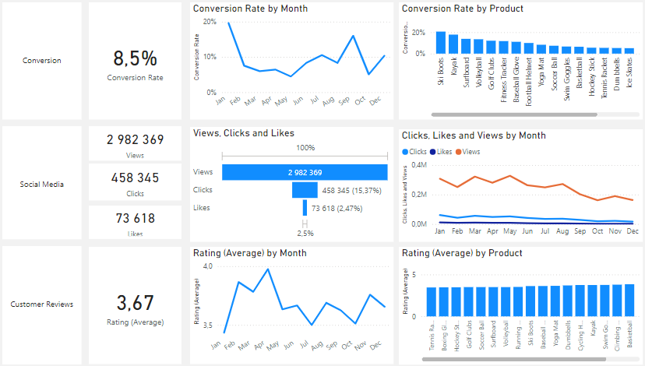
Overview
Conversion Rates: After experiencing a significant decline to 5.0% in October, the conversion rate showed a strong recovery in December, rising to 10.2%.
Customer Engagement:
Overall social media engagement declined throughout the year, with a noticeable drop in views.
Although clicks and likes remain low relative to views, the click-through rate is 15.37%, indicating effective interaction among engaged users..
Customer Feedback Analysis:
Customer ratings have remained consistent, averaging around 3.7 throughout the year.
Although stable, the average rating is below the target of 4.0, suggesting a need for focused improvements in customer satisfaction, for products below 3,5.

Slide 3
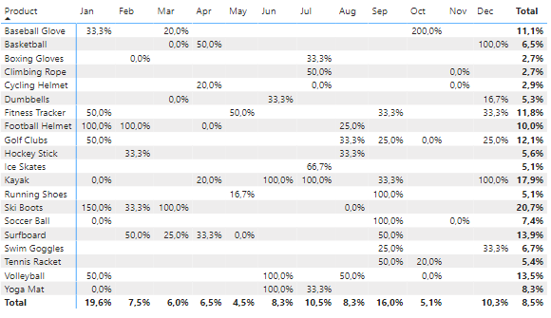
Conversion Rates
General Conversion Trend:
Conversion rates fluctuated throughout the year, with higher success observed in months like February and July. This indicates that while certain products benefited from seasonal demand, there is room to enhance conversions in underperforming months through strategic interventions.
Lowest Conversion Month:
May experienced the lowest overall conversion rate at 4.5%, with no products standing out significantly in terms of conversion. This suggests the need to reassess marketing strategies or promotions during this period to improve results.
Highest Conversion Rates:
January achieved the highest overall conversion rate at 19,6%, significantly boosted by the Ski Boots category, which saw an impressive 150% conversion rate. This reflects a strong start to the year, likely driven by seasonal demand and effective marketing efforts.

Slide 4
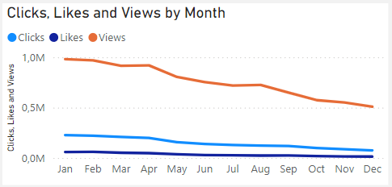
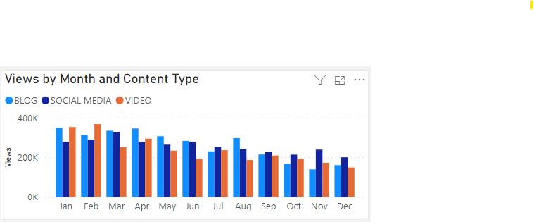
Customer Engagement
Declining Views:
Audience views reached their highest in February and July but showed a downward trend from August onwards, reflecting decreased engagement in the latter part of the year.
Low Interaction Rates:
Despite a significant number of views, clicks and likes stayed consistently low, highlighting a need for more captivating content or improved calls to action.
Content Type Performance:
Despite a significant number of views, clicks and likes stayed consistently low, highlighting a need for more captivating content or improved calls to action.

Slide 5
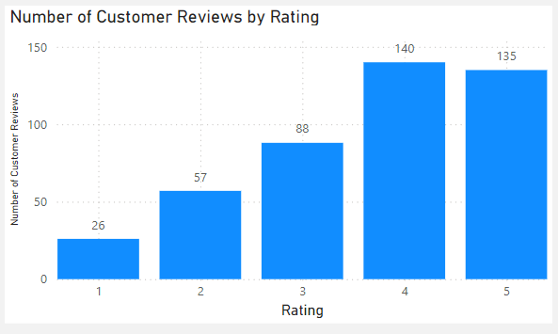
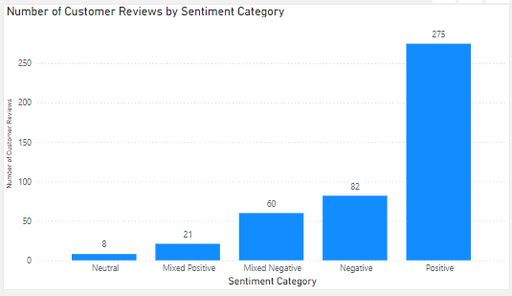
Customer Feedback Analysis
Customer Ratings Distribution:
The majority of customer feedback is highly positive, with 140 reviews rated at 4 stars and 135 at 5 stars. Lower ratings, such as 1-star (26 reviews) and 2-star (57 reviews), make up a smaller portion of the total.
Sentiment Analysis:
Most reviews reflect positive sentiment, with 275 expressing satisfaction. Negative sentiment appears in 82 reviews, alongside a smaller number of mixed or neutral sentiments, indicating room for improvement but overall strong approval from customers.
Opportunity for Improvement:
The presence of mixed feedback highlights an opportunity to convert these experiences into clearly positive ones. By addressing concerns raised in mixed reviews, the overall ratings and customer satisfaction could be significantly improved.

Slide 6
Goals & Actions
Goals
Actions
Increase Conversion Rates:
Goal: Identify factors impacting the conversion rate and provide recommendations to improve it.
Insight: Highlight key stages where visitors drop off and suggest improvements to optimise the conversion funnel.
Enhance Customer Engagement:
Goal: Determine which types of content drive the highest engagement.
Insight: Analyse interaction levels with different types of marketing content to inform better content strategies.
Improve Customer Feedback Scores:
Goal: Understand common themes in customer reviews and provide actionable insights.
Insight: Identify recurring positive and negative feedback to guide product and service improvements.
Increase Conversion Rates:
Boost High-Performing Product Sales: Products like Kayaks, Ski Boots, and Baseball Gloves achieved strong conversion rates. To maximise these trends, introduce seasonal promotions or personalised campaigns during peak months such as January and September.
Enhance Customer Engagement:
Review Content Strategy: Review content strategy to counter declining views and low interaction rates. Test engaging formats like interactive videos or user-generated content. Enhance call-to-action placement in social media and blog posts, focusing on improving engagement during typically low-performance months (September to December).
Improve Customer Feedback Scores:
Address Mixed and Negative Feedback: Address mixed and negative reviews by implementing a feedback analysis process to identify recurring issues. Create targeted improvement strategies and actively follow up with dissatisfied customers to resolve their concerns. Encourage re-ratings to help raise the average score closer to the 4.0 target.

